Slide 1
Database Design Chat 007
How does the cloud effect my relational db?

Slide 2
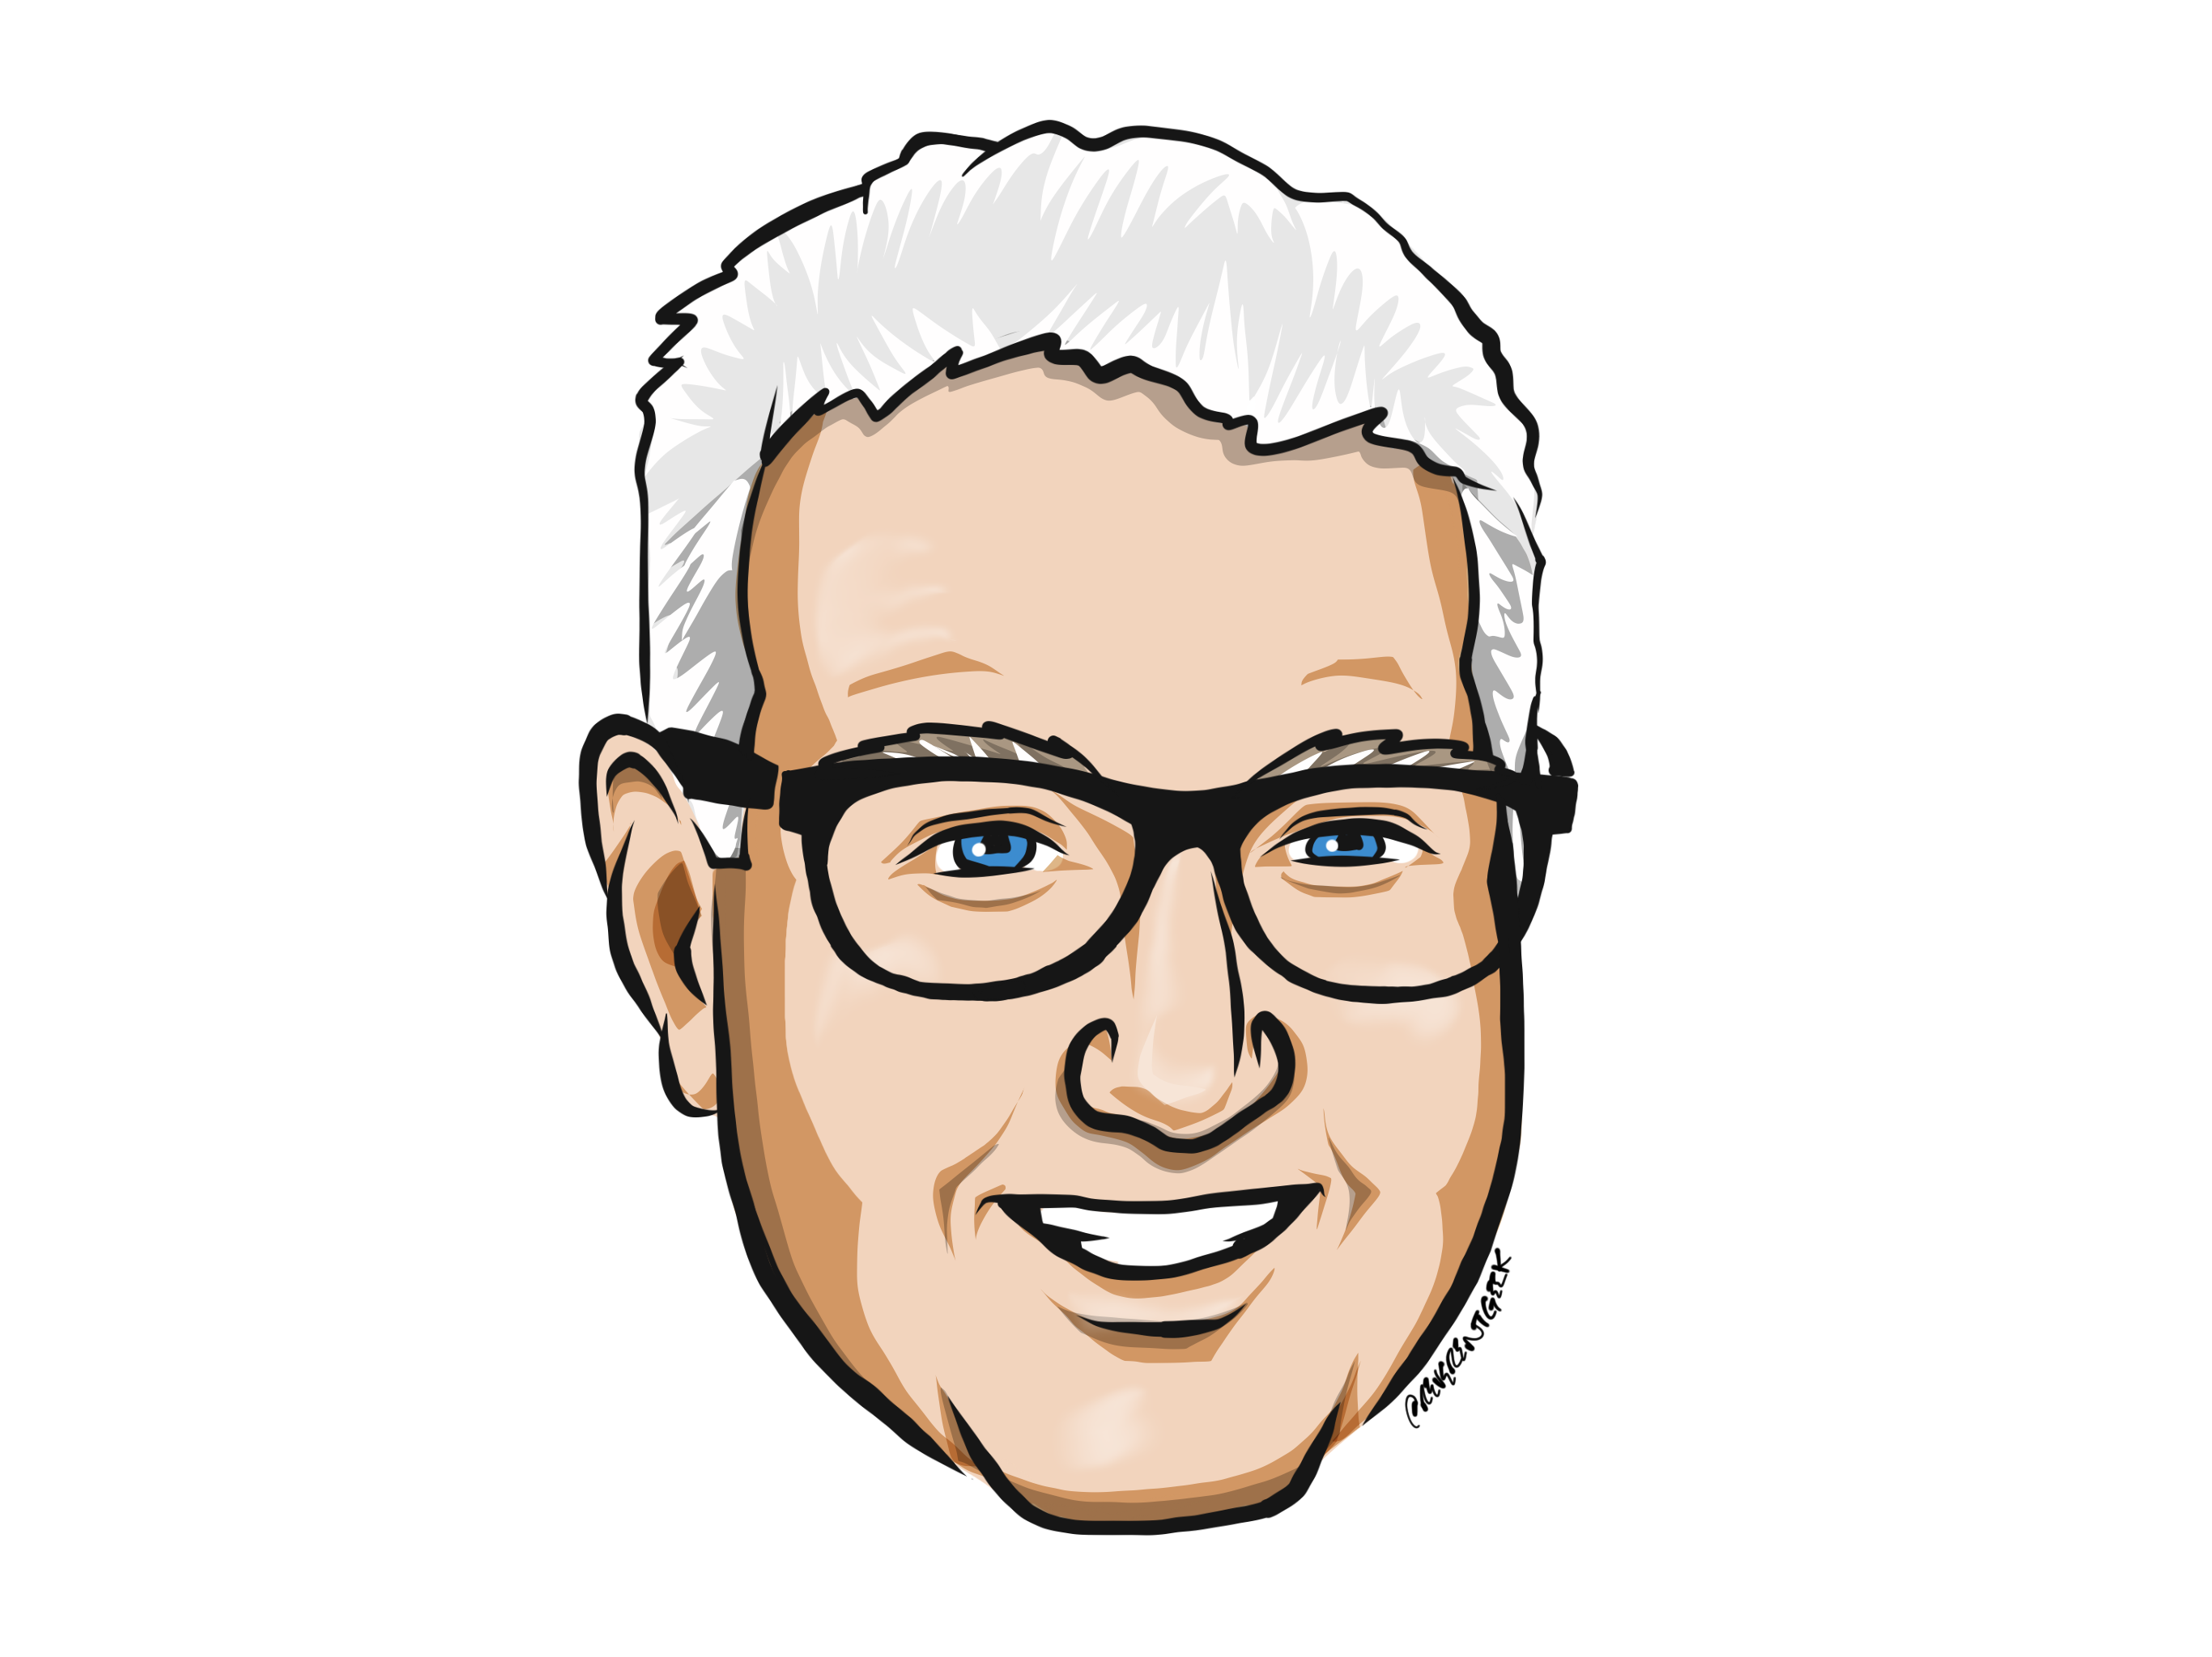
Louis Davidson (drsql)
https://linktr.ee/drsql

Slide 3
Mention Brent’s Keynote
I was watching Brent Ozar’s keynote at PASS..
How the cloud affects your career…
Key takeaways..
We suck at capacity planning, and the cloud “fixes” that..
I want to talk about
How the cloud affects your relational database design
Building dbs for 20+ years… 1 major breaking change… =*

Slide 4
Capacity planning
It was once thought that computers would be too fast
We didn’t have that much data to capture
No one would need one of these things in your home
Part of the capacity planning problem is that once you realize you can store one thing… well… you need to store even more.
As much as I have been about database design, I never conceived of the amount of data that we would try to store
Use watch as example. And you are and you are and I am talking to a camera, so this is getting silly.
So much data, and locally we buy expensive storage solutions, store boatloads of data… and never use it..
Cut to clip of me saying “Can you imagine how much data is being stored every second here? Me either’

Slide 5
The cloud to the rescue…
I don’t want to usurp Brent’s keynote, you need to watch it yourself
But the cloud can help out by letting us upgrade and downgrade resources quickly
But does our relational database structure need to change?
Note I said relational. Relational Databases are just one type of database
Data processing needs to be Atomic (all or nothing) Consistent (no corruption) Isolated (multiple users not harming others) Durable (computer shuts off, data is saved)
Knowing what a relational database management system is RDBMS in short is key to answering this question..

Slide 6
Bit of history
Edgar F Codd (along with others), formed what we know as a RDBMS in the early 80s.
Reading the 12 rules (actually 13, with a rule 0 stating you had to follow all the other rules or stop using the “brand name” relational), something becomes obvious…
The vision of an RDBMS has not yet been adequately achieved even what seems like a million years (the foundational papers came out while I was still a goofy kid just finishing high school)
<because is on the next page>

Slide 7

Goal of the RDBMS
Basically to provide a declarative experience where you ask the system a high level question about what has been stored (a query), and in reply you get an answer (results)
You should not care about
Where the data is
How the data is stored
The order of the data
How to access the data (rows and columns using a key value)
How to figure out what is in the database (a catalog is required)
How to go to the disk and modify data.. Just ask!
If the data will meet your requirements (constraints to constrain your data, no side access to data to corrupt it)
Sounds like utopia
<leads to next page>

Slide 8
It really is
One of the reasons why I was able to excel at being a programmer is that relational databases encapsulate a lot away from you.
That is not to say it is “easy”, but I am really quite bad at deep bits and bytes programming
I wrote my compiler in college in VB 1.0
You set up a database following a set of rules (Relational rules and Normalizing Rules, plus plenty of other things we will chat about in coming months)
And it just works. When you are storing relational data, typically transactional data

Slide 9
Sort of…
Remember how Brent said we suck at capacity planning…
Well, we also suck at understanding what the customer wants
Probably more than we suck at capacity planning
And the customers keep changing their dang minds!
Which is why it is good to be a programmer
Getting what the customer wants right is tantamount to achieving good performance and usability
All the relational model wants out of you is to design your model in a certain pattern based on what the customer wants to do with the data.
But we rarely understand what the customer wants and too often believe we are right…

Slide 10
The customer is always right
Well, at least eventually
Here’s the too often real scenario
Customer wants to do something dumb
Programmer tries to change customer’s mind
Customer still wants to do that dumb thing
Programmer does what they think the customer should have done
The output is less adequate than using a kitten as a pack mule
Which sounds cute, until the pack squishes the kitten

Slide 11
So what’s the point…
Relational databases are relational databases at heart
They are built (first) to work with normalized data that matches what the customer wants
Relational databases in the cloud are relational databases
Is this getting too deep ☺
The cloud just makes it better because the vendor‘s algorithms can watch your usage (not your specific data, or at least, humans don’t have to see it), and see what needs improvement using extra system band width

Slide 12
Microsoft’s Azure platform RDBMS…
Microsoft has 3 flavors of in the cloud relational SQL Server (and other vendors products in Azure as well!)
Azure SQL Database –fully managed, put data in, they do most of the work for you (including tuning your system, adding indexes, etc)
Managed Instances - less managed – but they do a lot of the work for you
Slightly managed – infrastructure as a service, basically you install sql on a machine and use it like normal
The first two are green field, always up to date…
How hard has it always been to update to the next version of SQL… and no one suggested upgrading in place…
the third is far more manually managed…for when you
All have basically the same engine…

Slide 13
So the answer is…
The answer is basically in that previous sentence…
Your relational code stays largely the same
Some esoteric features work (or don’t work) in different versions (or even different platforms like SQL Server on Linux)
But overall… it just works. Thanks to the vision Codd had over 30 years ago, we can just sit down, write a simple question and let the computer figure out the right way to answer it… even if sometimes it needs a little help from someone who knows the engine.

Slide 14
Final point
I always like to think that the relational engine is magic
It isn’t
If you are watching this, you are probably a programmer/engineer
If you don’t know what the software is doing (at least at an abstract level), then you are a user
Users are great, but a programmer or engineer not only knows what button to push, they know why pushing that button is right, and typically what can go wrong after it is pushed…
Don’t be a user if you want to be a good programmer or engineer…

Slide 15
Until Next Time…
Time for a break for the holidays…
When I come back… I have chats planned on
Relational form (what makes a table a table)
First Normal Form
Designing for uniqueness
Performance
Second and Third Normal Form
Coherency
And even our good friend NULL

Slide 16
Thankful
Until then, let me tell you what I am thankful for. You. (and as I only so far have a few viewers, the whole SQL community.
I wouldn’t be what I am today without this great community
Get involved if you can… sponsor… organize… speak.. Even just attend...

Slide 17
Questions?
If you have questions, you can:
Comment on YouTube
Email drsql@hotmail.com
Message me on Twitter at drsql
Contact me anywhere on https://linktr.ee/drsql
I may add an episode to discuss or reply directly

